Slide 1




Noida Institute of Engineering and Technology, Greater Noida
High Performance Computing
Unit: 4
Ms. Kashish Mahajan
Assistant Professor
CS-DEPT
NIET
Cluster Computing
B-Tech 3rd Sem

Slide 2

Faculty Profile
FACULTY PROFILE
Name of Faculty: Ms. Kashish Mahajan
Designation & Department: Assistant Professor , CS Dept.
Qualification: M.Tech in Cloud (BITS Pilani) + UGC Net
Experience: Have 3 years experience in industry as Software Engineer in NTT Data.

Slide 3

Evaluation Scheme
B.Tech. (Computer Science CS)
Core subject
3rd SEMESTER
PREDICTIVE ANALYTICS

Slide 4

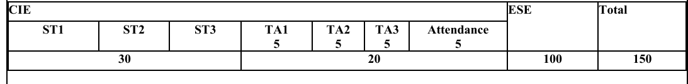
Mode of Evaluation

Slide 5
Teaching Pedagogy
Slide Based Concept Delivery
PowerPoint slides are used for each module to explain the key concepts with a proper structure.
Board Teaching for Flow and Diagram
A traditional black/white board is used to explain the logical flow of processes along with diagrams and interlinking concepts.
Hands on Practical Demonstration
Practical aspects and coding implementations on OpenMp, CUDA will be demonstrated to students. This will help them visualize real-time outputs, understand syntax and logic and gains experience.

Slide 6
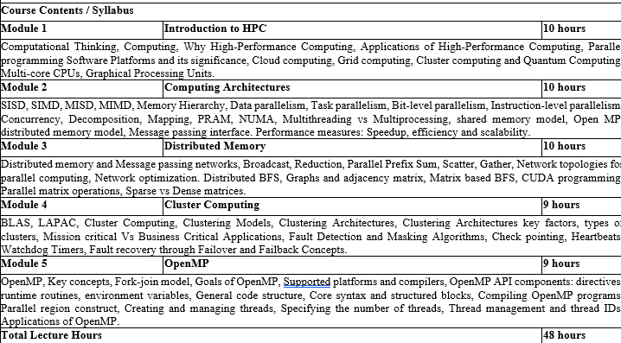
Course Contents / Syllabus

Slide 7
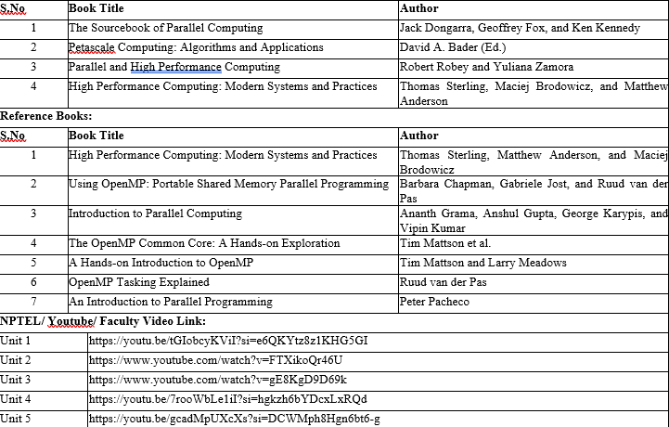
Book Title/ External Links as per Syllabus

Slide 8
Branch wise Applications
Computer science encompasses a diverse array of specialized fields that address modern technological challenges and innovations. Artificial Intelligence (AI) & Machine Learning (ML) empower systems to perceive, learn, and make decisions—from voice assistants and medical diagnostic tools to autonomous vehicles . Data Science & Big Data blend statistics, data modeling, and programming to uncover insights for business intelligence, fraud detection, and predictive analytics. Software Engineering focuses on the full lifecycle of building robust applications—from mobile and web platforms to enterprise and industrial systems . In Cybersecurity & Cryptography, specialists design secure protocols and systems to protect networks, financial infrastructure, and sensitive personal data. Cloud Computing & DevOps enable scalable on-demand services, powering online gaming, streaming, and enterprise applications with automated deployment pipelines . Fields like Computer Graphics & Visualization, Computer Vision, and HCI focus on visual, interactive, and user-centric computing, driving VR/AR, gaming, medical imaging, and intuitive interfaces. Algorithms & Data Structures form the theoretical backbone, optimizing search, encryption, and data retrieval while informing compiler and database design. At the hardware level, Computer Architecture & Embedded Systems support IoT, smart devices, and robotics through efficient design of processors and sensors . Blockchain & Distributed Systems revolutionize secure, decentralized applications in finance and supply chains. Emerging areas like Quantum Computing and Neuromorphic/Biological Computing promise breakthroughs in simulation, optimization, and ultra-efficient intelligent systems—whether using qubits to accelerate drug discovery or neuronal circuits to mimic brain-like computation .

Slide 9
Course Objective
The objective of this course is -
Fundamental HPC Concepts & Terminology Introduce students to essential HPC concepts like parallelism, scaling, and performance (speedup vs. efficiency). Explain why HPC is vital across scientific and engineering domains
Understanding Modern Architectures Cover shared‑memory and distributed systems (clusters, GPUs, accelerators), their architectures, and how hardware design influences software performance.
Mastery of Parallel Programming Models Teach key parallel programming paradigms:
Shared memory: OpenMP
Distributed memory: MPI
Hardware-accelerated: CUDA, OpenCL, OpenACC

Slide 10
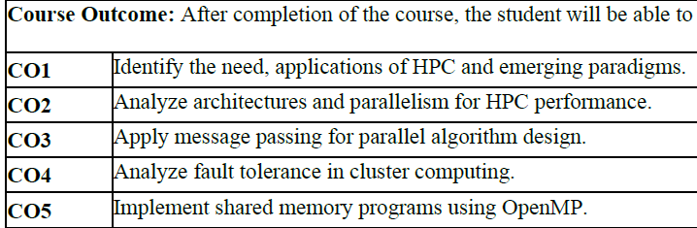
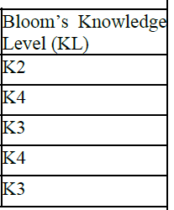
Course Outcomes

Slide 11

Program Outcomes
Engineering Graduates will be able to Understand:
1. Engineering knowledge
2. Problem analysis
3. Design/development of solutions
4. Conduct investigations of complex
5. Modern tool usage
6. The engineer and society
7. Environment and sustainability
8. Ethics
9. Individual and team work
10. Communication
11. Project management and finance
12. Life-long learning

Slide 12
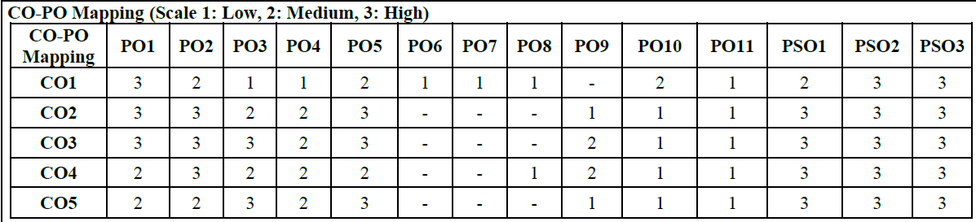
CO-PO Mapping

Slide 13
Program Specific Outcomes (PSOs)
PSO’s
At the end of the program, the student will be able to-
PSO 1: Apply suitable techniques, modern tools to solve complex engineering problems in the field of computer science.
PSO 2: Design and optimize, ethical and innovative solutions for the betterment of the society.
PSO 3: Work as an individual or lead in a team with good communication and engage in life-long learning.

Slide 14
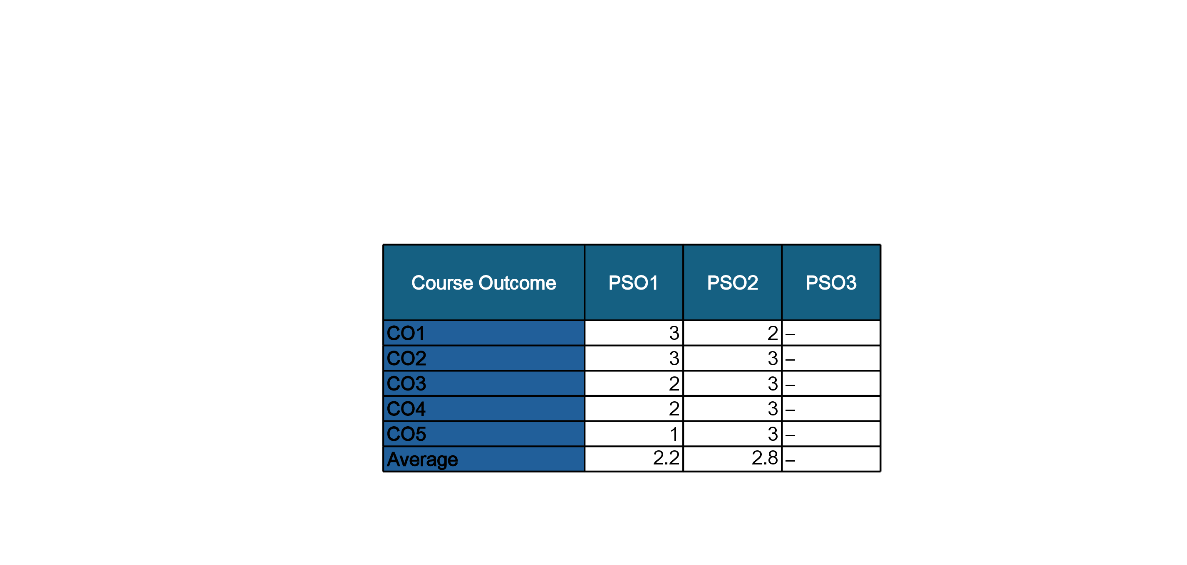
COs and PSOs Mapping

Slide 15
Program Educational Objectives (PEOs)
PEO’s
The graduates of B.Tech Computer Science program will-
PEO1: Have successful careers in the field of Computer Science and pursue higher education.
PEO2: Engage in research and provide innovative solution to real world problems of the society with ethical responsibilities.
PEO3: Demonstrate effective communication, work as an individual or as a team and engage in life-long learning.

Slide 16
Prerequisite and Recap
Prerequisites:
Language proficiency in C, C++ or Fortran – essential for working
Recap:
High Performance Computing
Computing Architectures
Distributed memory and Message passing networks

Slide 17

Question Paper Template

Slide 18
Question Paper Template
 |  | SECTION – A |  | CO
 | Attempt all parts- |  | [10×1=10]
 | 1-a. | Question- | (1)
 | 1-b. | Question- | (1)
 | 1-c. | Question- | (1)
 | 1-d. | Question- | (1)
 | 1-e. | Question- | (1)
 | 1-f. | Question- | (1)
 | 1-g. | Question- | (1)
 | 1-h. | Question- | (1)
 | 1-i. | Question- | (1)
 | 1-j. | Question- | (1)
2. | Attempt all parts- |  | [5×2=10] | CO
 | 2-a. | Question- | (2)
 | 2-b. | Question- | (2)
 | 2-c. | Question- | (2)
 | 2-d. | Question- | (2)
 | 2-e. | Question- | (2)
SECTION – B |  |  |  | CO
3. | Answer any five of the following- |  | [5×6=30]
 | 3-a. | Question- | (6)
 | 3-b. | Question- | (6)
 | 3-c. | Question- | (6)
 | 3-d. | Question- | (6)
 | 3-e. | Question- | (6)
 | 3-f. | Question- | (6)
 | 3-g. | Question- | (6)
SECTION – C |  |  |  | CO
4 | Answer any one of the following- |  | [5×10=50]
 | 4-a. | Question- | (10)
 | 4-b. | Question- | (10)
5. | Answer any one of the following-
 | 5-a. | Question- | (10)
 | 5-b. | Question- | (10)
6. | Answer any one of the following-
 | 6-a. | Question- | (10)
 | 6-b. | Question- | (10)
7. | Answer any one of the following-
 | 7-a. | Question- | (10)
 | 7-b. | Question- | (10)
8. | Answer any one of the following-
 | 8-a. | Question- | (10)
 | 8-b. | Question- | (10)

Slide 19
Brief Intro of Subject with video
High Performance Computing (HPC) focuses on solving complex computational problems using parallel and distributed computing technologies. In today’s era of large-scale data and simulation-driven systems, HPC enables faster processing and analysis by harnessing the power of modern hardware and software tools like multi-core processors, clusters, grids, and even quantum systems.
Students learn:
Core concepts of cluster computing
Clustering Architectures
Fault Detection and Masking Algorithms
Fault recovery through Failover and Failback Concepts.
This course builds the foundation to design, implement, and analyze performance-driven software and systems used in scientific research, machine learning, big data, etc.
Topic-wise Video Lectures (YouTube/NPTEL)
Module 4 https://youtu.be/7rooWbLe1iI?si=hgkzh6bYDcxLxRQd

Slide 20
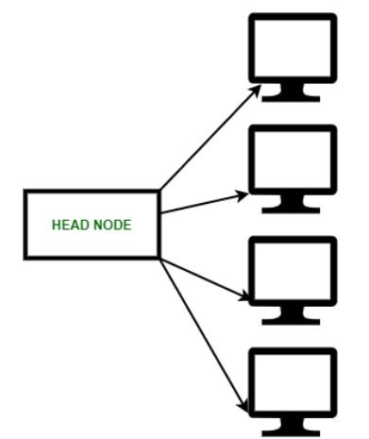
Cluster Computing
What is a cluster?
A cluster refers to a group of interconnected computers, often called nodes, that work together as a single system to perform tasks.
The components of a cluster are usually
connected to each other through fast
local area networks, with each node
(computer used as a server) running its
own instance of an operating system.
Examples of cluster applications:
High-Performance Computing: Used for scientific research, simulations, and other computationally intensive tasks.
Web Hosting: Clusters can handle high traffic and provide reliable service for websites and web applications.

Slide 21
Classification of Cluster
Cluster computers are classified into two different categories based on security:
Open Cluster: All computers need IP addresses in the Open cluster. These IPs are available on the internet which is a security concern.
Close Cluster: All the nodes hide behind the gateway node. This gateway node increases the protection of other nodes.

Slide 22

What is Cluster Computing?
Cluster computing is a type of computing where multiple computers are connected so they work together as a single system.
Computing clusters typically consist of servers, workstations and personal computers (PCs) that communicate over a local area network (LAN) or a wide area network (WAN).
Cluster computing is a kind of distributed computing, a type of computing that links computers together on a network to perform a computational task, increase computational power and function as a single computer.
Google search engine, Earthquake simulations, and Weather forecasting use clustering techniques.

Slide 23
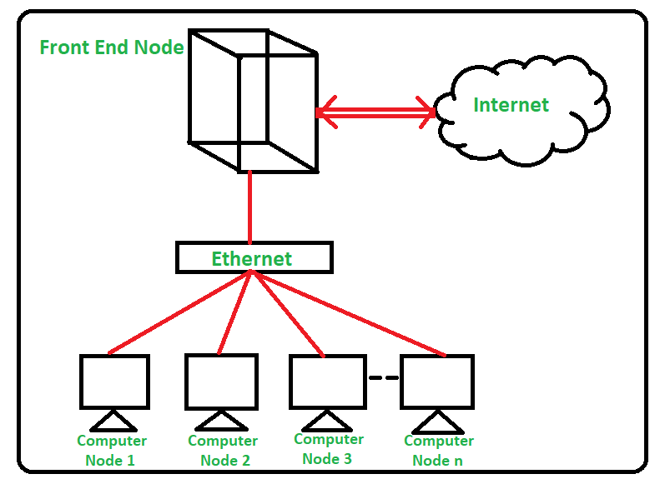
How does Cluster Computing Work?
Cluster computing connects two or more computers over a network to work cohesively as a single system.
Typically, a cluster setup consists of computing nodes, a leader node, a load balancer, and a heartbeat mechanism.
When the leader node receives a request, it passes the task to the computing nodes.
According to how engineers configure the cluster, each node may act on the task separately or concurrently.
Each component is explained below:

Slide 24
How does Cluster Computing Work?
Computing nodes
Computing nodes are servers (or cloud instances) that work on distributed tasks. Often, they share the same CPU, GPU, memory, storage, operating system, and other computing specifications. We call this a homogeneous setup. A heterogeneous setup may sometimes be used, where some cluster nodes bear different computing specifications.
Leader node
A leader node is a computer assigned to coordinate how other computing nodes work together. The leader node receives incoming requests and distributes tasks to different nodes under its charge. If the leader node fails, another node will take its place through an election process, usually by consensus of the remaining nodes.
Load balancer
The load balancer is a network device that distributes incoming traffic to the appropriate computing nodes. It keeps track of network activities, resource usage, and data exchange between cluster nodes. In cluster computing, the load balancer prevents computing nodes from being overwhelmed by a sudden surge in requests. Sometimes, the leader node acts as a load balancer through a dedicated load-balancing software tool.

Slide 25
How does Cluster Computing Work?
Heartbeat mechanism
The heartbeat mechanism monitors all computing nodes in the cluster to ensure they are operational. When a node fails to respond, the heartbeat mechanism alerts the leader node, redistributing the task to other functional nodes.

Slide 26
Pros and Cons of Cluster Computing
Pros
Cost-Effective: Cluster computing is less expensive than a mainframe computer and it also provides faster performance than the mainframe computer network.
Processing Speed: Cluster systems provide the same processing speed as that of mainframe computers.
Resource availability: Computers may also face some technical issues. When a computer in
a cluster fails to operate, the other available computer takes over the operations of the failed computer.
Expandability: We can combine multiple additional computers to the cluster network whenever necessary. This advantage enhances scalability and expandability.
Flexibility: The existing computer or node can be upgraded as per the requirements to perform operations.
Cons
Finding Faults: Difficult in finding the fault due to a large amount of hardware.
Space Needed: Infrastructure may also increase and more servers will be required to monitor the operations.

Slide 27
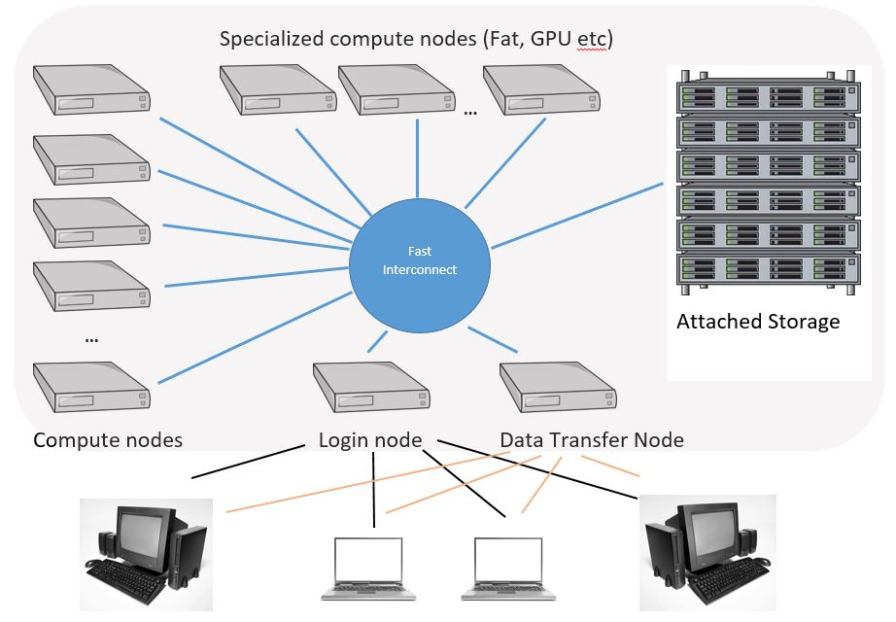
Types of Cluster Computing
High performance (HP) clusters :
HP clusters use computer clusters and supercomputers to solve advance computational problems. They are used to performing functions that need nodes to communicate as they perform their jobs. They are designed to take benefit of the parallel processing power of several nodes.

Slide 28
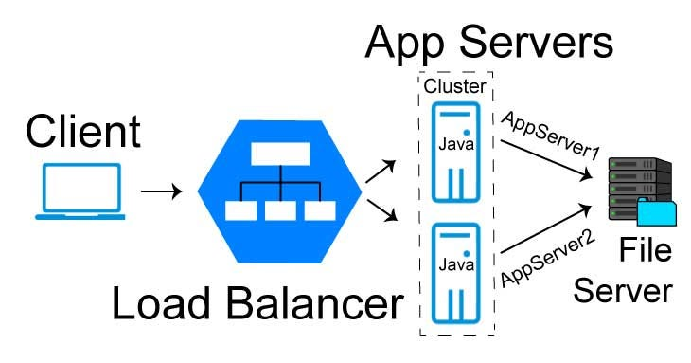
Types of Cluster Computing
Load-balancing clusters :
Incoming requests are distributed for resources among several nodes running similar programs or having similar content. This prevents any single node from receiving a disproportionate amount of task. This type of distribution is generally used in a web-hosting environment.

Slide 29
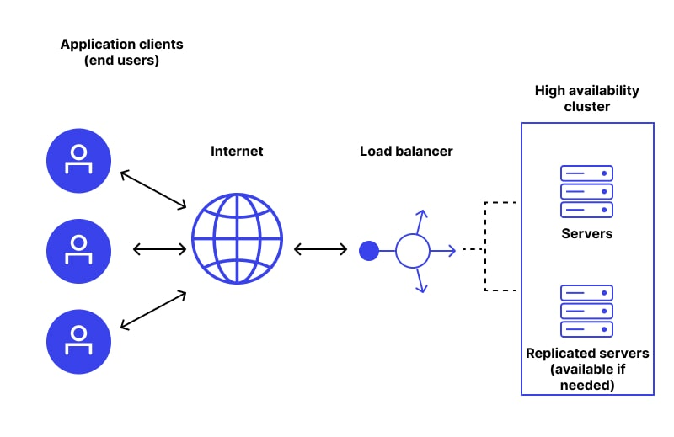
Types of Cluster Computing
High Availability (HA) Clusters :
HA clusters are designed to maintain redundant nodes that can act as backup systems in case any failure occurs. Consistent computing services like business activities, complicated databases, customer services like e-websites and network file distribution are provided. They are designed to give uninterrupted data availability to the customers.

Slide 30
Cluster Computing Architecture
It is designed with an array of interconnected individual computers and the computer systems operating collectively as a single standalone system.
It is a group of workstations or computers working together as a single, integrated computing resource connected via high-speed interconnects.
A node – Either a single or a multiprocessor network having memory, input and output functions and an operating system.
Two or more nodes are connected on a single line or every node might be connected individually through a LAN connection.

Slide 31
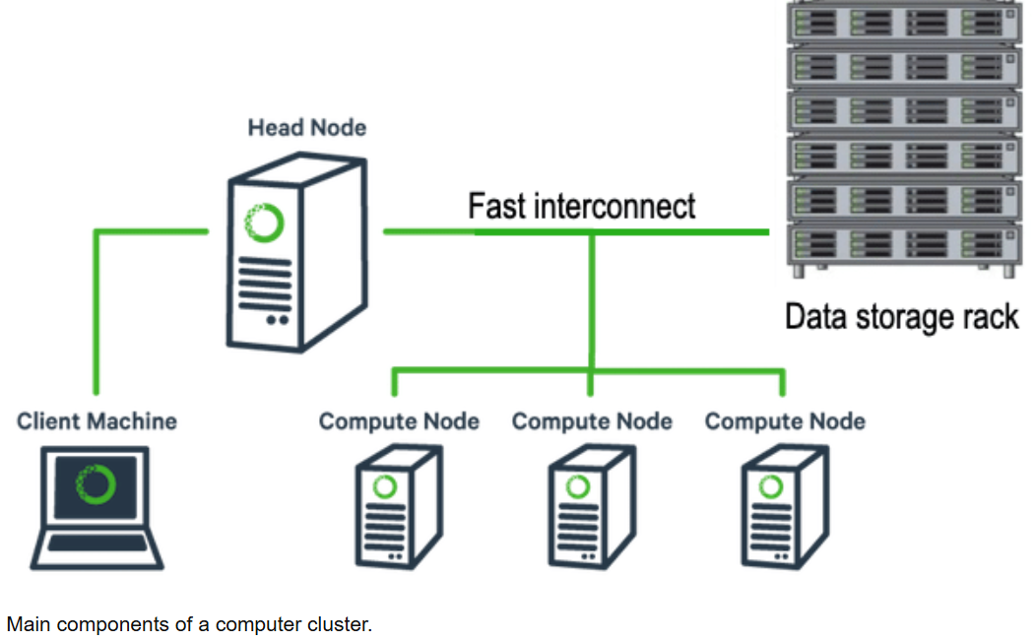
Components of a Cluster
Image Source: Research Gate

Slide 32
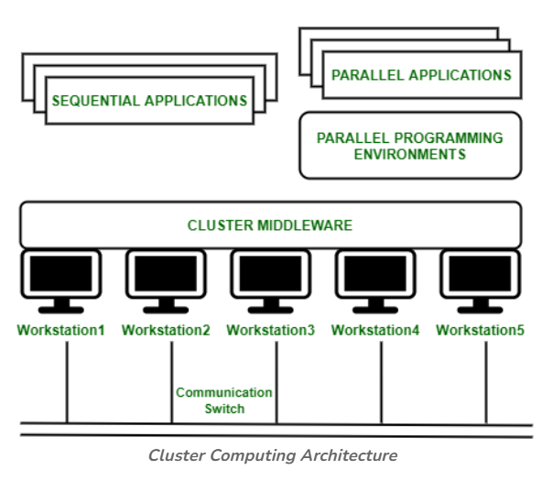
Contd.
Image Source: geekforgeeks

Slide 33
Contd.
The architecture is organized in layers that manage applications, programming environments, middleware, and hardware components.
Architecture Layers
Applications Layer: At the top, there are two types of applications—sequential and parallel applications. Sequential applications run on a single node, while parallel applications can utilize multiple nodes for distributed computation.​
Parallel Programming Environments: This layer provides programming frameworks and libraries (such as MPI, OpenMP, CUDA, etc.) that facilitate writing code capable of running across multiple nodes in parallel.
Cluster Middleware: Middleware sits between the programming environments and the hardware. It manages resource allocation, task scheduling, fault tolerance, inter-process communication, and abstraction of underlying hardware to the user/application layer.​
Hardware Layer: The hardware layer consists of several interconnected workstations (nodes), labeled Workstation1 through Workstation5. These nodes are physically connected via a communication switch, which enables data transfer and coordination between nodes.

Slide 34
Cluster Computing Load Balancing Algorithms
The following are some prominent components of cluster computers:
Multiple High-Performance Computers (PCs, Workstations, or SMPs)
Operating Systems (Layered or Micro-kernel based)
High Performance Networks/Switches
Network Interface Cards (NICs)
Fast Communication Protocols and Services (such as Active and Fast Messages)
Cluster Middleware (Single System Image (SSI)
Hardware (such as Digital (DEC)
Memory Channel
Hardware DSM

Slide 35
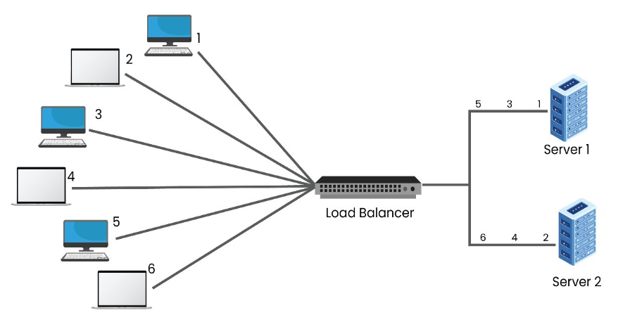
Cluster Computing Load Balancing Algorithms
Some of the common load balancing algorithms in Cluster computing are:
Round Robin Algorithm:
In the below diagram, there are two servers awaiting requests behind the load balancer. Upon the arrival of the first request, the load balancer will forward the request to Server 1 and after getting the second request, it is allotted to Server 2. As there are only two servers in the network, the next request will again be forwarded to Server 1—this way, the requests are sent to both the servers in a cyclic format.

Slide 36
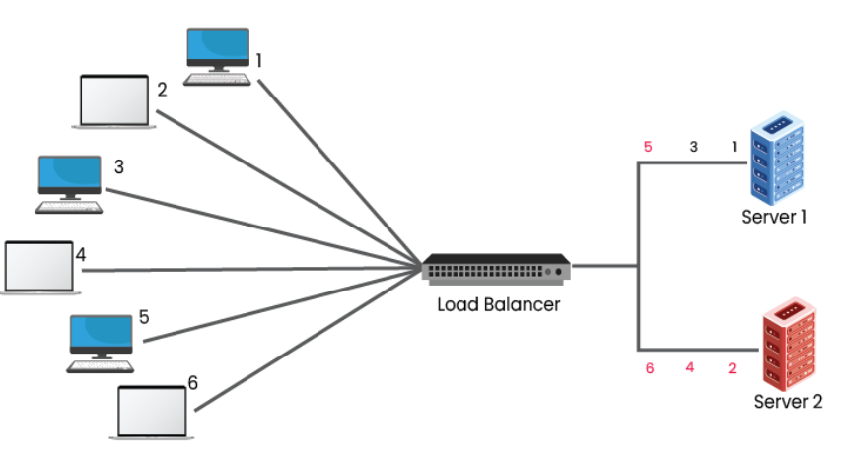
Cluster Computing Load Balancing Algorithms
Least Connections:
The Least Connections Algorithm considers the number of connections that each server currently has. Whenever there is a connection request, the load balancer determines which of the servers has the least number of connections and then the new connection will be assigned to that server.

Slide 37
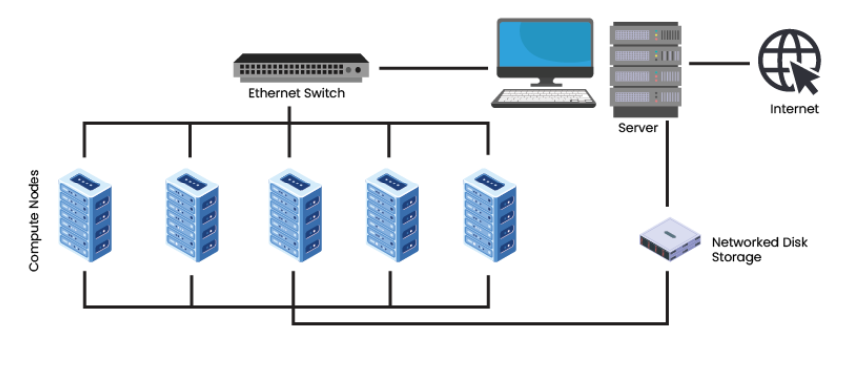
Cluster Computing Load Balancing Algorithms
Beowulf Clusters:
One of the most remarkable technology advancements today has been the growth of Personal Computers’ computing performance. The Beowulf Cluster was created to achieve the rising high-performance power in certain scientific areas for developing a powerful and affordable Cloud computing system. The constant evolution of performance, processor, and collaboration between PCs and workstations resulted in decreased network processors’ reduced costs for influencing the improved high-performance clusters. A Beowulf cluster is a computer cluster of normally identical, commodity-grade computers networked into a small local area network with libraries and programs installed that allow processing to be shared among them. The result is a high-performance parallel computing cluster from inexpensive personal computer hardware.

Slide 38
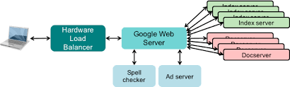
Google Cluster Architecture

Slide 39
Key Factors in Clustering Architectures
Scalability: Ability of the cluster to grow (add more nodes) without significant loss in performance. Essential for workloads that grow with data size (e.g., weather modeling, genomics)
Performance: How efficiently the cluster processes tasks (throughput, latency). It is determined by Node hardware, Network speed
Fault Tolerance and High Availability: Ability of the cluster to continue functioning when one or more nodes fail. Implemented via: Redundant nodes, health monitoring.
Load Balancing: Even distribution of workload across all nodes. Prevents idle nodes and bottlenecks. It can be Static or Predefined distribution and Dynamic which is adjusted during runtime based on load.
Network Architecture: How nodes are connected and communicate. Can be Star, Mesh, Ring, Torus, Hypercube

Slide 40
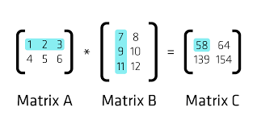
BLAS
BLAS (Basic Linear Algebra Subprograms) are a set of foundational routines for performing basic vector and matrix operations, widely used in high-performance computing (HPC).
When we talk about BLAS in the context of cluster computing, it involves using BLAS-like routines across multiple nodes of a distributed system to perform high-performance linear algebra computations.
These routines are categorized into three levels based on the types of operations they handle:
Level 1 : Focuses on vector-vector operations like dot products, scaling, and vector additions.
Level 2 : Deals with matrix-vector operations, such as matrix-vector multiplication.
Level 3 : Involves matrix-matrix operations, with matrix multiplication being a key example.

Slide 41
BLAS
Why are BLAS important in HPC?
Performance:
BLAS implementations are highly optimized for specific hardware architectures, delivering significant performance gains compared to naive implementations.
Portability:
The standardized interface of BLAS allows users to easily switch between different BLAS libraries without modifying their code.
Foundation for other libraries:
BLAS serves as a foundation for more advanced linear algebra libraries like LAPACK, which are extensively used in HPC.
Libraries: OpenBLAS, Intel MKL (Math Kernel Library), CUDA BLAS (cuBLAS)
Ex: MATLAB, NumPy

Slide 42
LAPLACK
LAPACK (Linear Algebra PACKage) is a widely used library of numerical linear algebra routines, crucial for high-performance computing (HPC). It provides optimized functions for solving linear equations, eigenvalue problems, and singular value decomposition.
By itself, LAPACK is meant for single-node, shared-memory systems. However, in cluster environments where memory and CPU resources are distributed across multiple nodes, LAPACK needs an extension: ScaLAPACK (Scalable LAPACK).
Key aspects of LAPACK in HPC:
High Performance:
LAPACK is designed to be highly efficient and can leverage multiple CPU cores and specialized hardware like GPUs for faster computations, especially for large matrices.
Portability:
It is designed to be portable across different platforms (Windows, macOS, Linux) and hardware architectures.

Slide 43
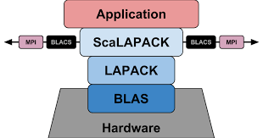
LAPLACK
Extensive Functionality:
LAPACK provides a wide range of routines for solving linear systems, least squares problems, eigenvalue and singular value decomposition, and more.

Slide 44
Mission critical Vs Business Critical Applications
Mission critical Applications:
These are essential for the survival or core function of an organization or operation.
Failure or downtime can lead to loss of life, irreversible damage, or catastrophic failure in business operations or public safety.
Usually operates in real-time, with zero tolerance for downtime.
Extremely high security
Real-time, automated alerts and self-healing systems are used.
Ex: ICU patient monitoring, satellite command

Slide 45
Mission critical Vs Business Critical Applications
Business critical Applications:
These are vital for day-to-day business operations, revenue, or customer satisfaction.
Failure leads to major financial or reputational loss, but does not threaten the organization's core survival.
Some level of planned downtime or failover mechanisms is acceptable.
Frequent but not always real-time monitoring
Ex: ERP systems, e-commerce platforms, Online banking
Cluster computing provides redundancy, scalability, high availability, fault tolerance, and performance—all of which are foundational for both mission-critical and business-critical systems. Ex: In ICU Monitoring System, real-time data processed is and replicated by clusters

Slide 46
Fault Detection and Fault Masking
Fault Detection:
Identifying that a component (node, process, link) has failed or is behaving incorrectly.
Fault Masking:
Ensuring system continues to function correctly even when faults occur often by hiding or correcting the fault.
These are essential for high availability, reliability, and fault tolerance in HPC clusters, distributed databases, real-time systems, and mission/business-critical applications.
Examples in HPC:
Node failure: Detecting a node failure (using log monitoring or machine learning) and masking it by rescheduling jobs to other available nodes.
Memory errors: Detecting memory errors (using error detection codes) and masking them by re-reading the data from another location.

Slide 47

Fault Detection
In cluster/distributed systems, early detection of faults is critical for:
Ensuring high availability
Triggering failovers
Maintaining consistency
Preventing system-wide crashes
Fault Detection Algorithms:
Heartbeat Mechanism
Timeout-Based Detection
Failure Suspectors (Crash Detection with Assumptions)
Consensus-Based Detection
Watchdog Timers
Check pointing

Slide 48

Check pointing
Checkpointing is the process of saving the state of a running application or system at regular intervals so that it can resume from the last saved state after a failure , instead of starting from scratch.
It helps to:
Minimize computation loss
Allow recovery after failures
Essential in long-running or mission-critical computations
Types of Checkpointing:
Full Checkpointing: Saves complete memory, files, states
Incremental: Saves only changes since the last checkpoint
Coordinated: All processes in a distributed system checkpoint simultaneously to maintain consistency
Uncoordinated: Processes checkpoint independently (can lead to "domino effect" – rollback of many processes)
Application-level: Handled by app logic (more optimized)
System-level: Transparent to application (e.g., CRIU in Linux)

Slide 49
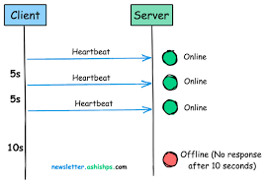
Heartbeat Mechanism
A heartbeat is a periodic signal/message sent from one system component to another to indicate that it is alive and functioning.
It helps to:
Monitor liveness of nodes, services, or applications
Trigger failure detection if heartbeat is not received within timeout
Used in clusters for failover, leader election, and service discovery

Slide 50
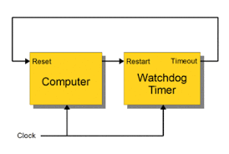
Watchdog Timers
A watchdog timer is a hardware or software timer that resets or takes corrective action if the monitored process fails to respond or behave properly within a certain time window.
It helps to:
Detect hangs or deadlocks
Auto-restart or reset unresponsive components
Ensure system reliability in embedded and real-time systems

Slide 51
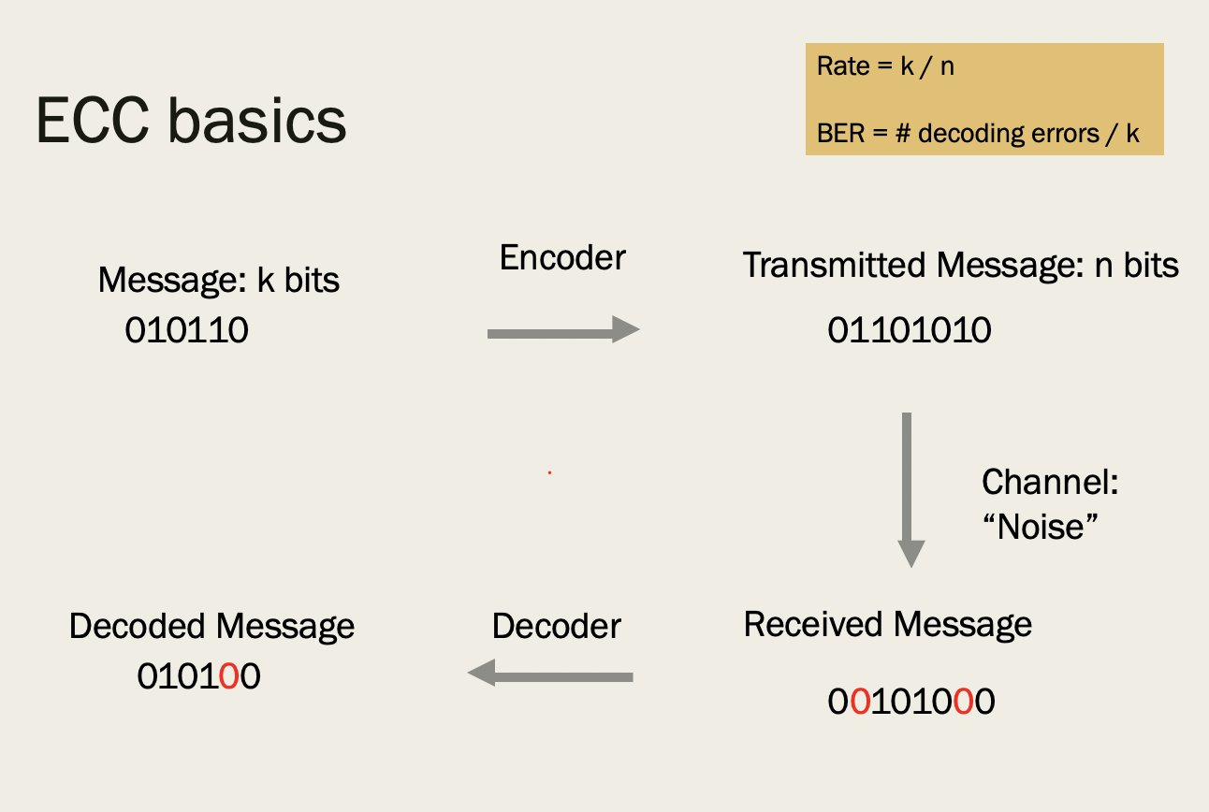
Error-Correcting Codes (ECC)
ECC, or Error Correction Code, is a technique used to detect and correct errors in data, particularly in memory and data transmission.
It adds extra bits to the original data, creating redundancy that allows the system to identify and fix errors that might occur due to noise, interference, or other factors.
This ensures data integrity and reliability, especially in critical systems like servers and storage devices.

Slide 52
Fault Masking
Fault masking is the process of hiding faults so that they do not affect the overall behavior of the system.
Rather than just detecting faults, masking allows the system to tolerate and continue operating correctly — a key requirement for fault-tolerant computing.
Fault masking algorithms:
Triple Modular Redundancy (TMR): Three identical modules (hardware/software) execute the same task. Their outputs are voted on by a majority.
Replication with Voting
Algorithm-Based Fault Tolerance (ABFT): Modifies algorithms to include redundancy and error correction capabilities directly within the computation. For example, matrix multiplication algorithms can be adapted to detect and correct errors during the calculation.
Checkpointing and Restart: Running multiple instances of a computation and using a voting mechanism to determine the correct result. If one instance produces an incorrect result, the majority vote (or a designated "reliable" instance) determines the correct output.

Slide 53
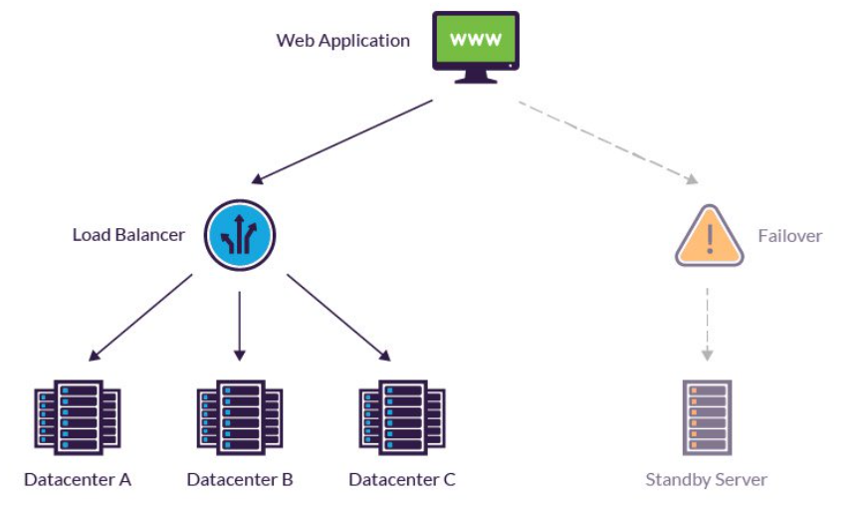
Fault Recovery
Fault recovery is the process of restoring normal operation of a system after a component fails- whether it's a server, network link, database, or application.
Recovery may involve switching to a backup system (failover), and returning to the original system when it's healthy (failback).

Slide 54
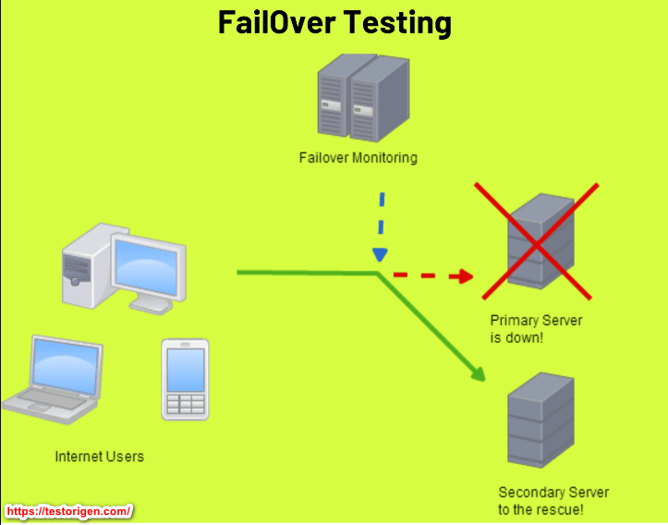
Failover
Failover is the mechanism of transferring workload and data processing from a primary system to a secondary system due to a failure or planned outage.
It provides immediate redundancy and ensures that critical services remain available despite system issues.
Examples:
Switching from a primary database server to a replicated database server.
Initiating a virtual machine (VM) failover to a backup VM in a different location.
Phases:
Failover typically involves:
Detecting the failure
Initiating the switch to the backup system
Redirecting traffic.

Slide 55
Failback
Failback is the process of returning operations from the secondary system back to the original, now restored, primary system.
Once the primary system is deemed operational, failback ensures that the system returns to its normal, preferred state.
Examples:
Replicating any changes made on the backup VM back to the original VM.
Redirecting website traffic back to the original, now repaired, server.
Phases:
Failback involves ensuring the primary system is functioning correctly
Synchronizing data between the systems
Redirecting traffic back to the primary.

Slide 56
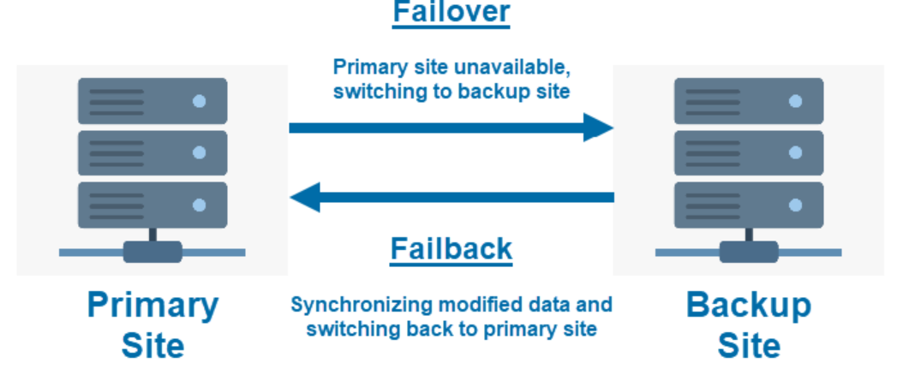
Failback

Slide 57
Importance in Disaster Recovery
Business Continuity:
Both failover and failback are critical components of a robust disaster recovery plan, ensuring that businesses can continue operating even when faced with unexpected outages.
Reduced Downtime:
By enabling rapid switching to backup systems, failover minimizes downtime and its associated costs.
Data Protection:
Failover and failback processes often involve data replication, ensuring data consistency and availability across systems.
In essence, failover and failback work in tandem to provide fault tolerance and business continuity, allowing organizations to recover from system failures and maintain operational efficiency.

Slide 58
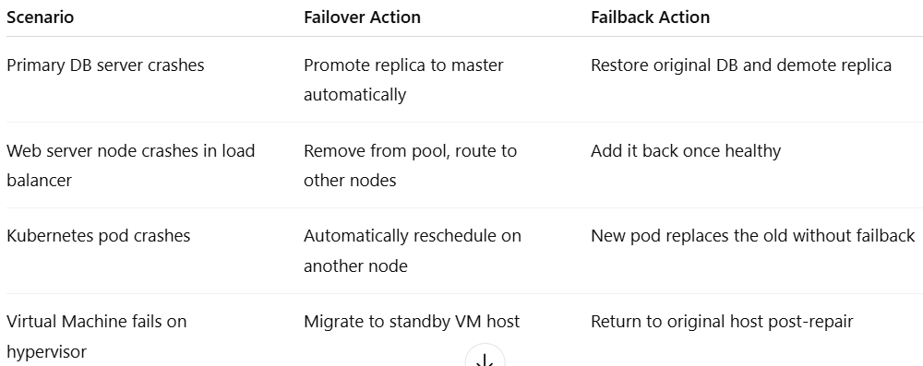
Real-World Example in a Clustered System

Slide 59
Daily Quiz
BLAS (Basic Linear Algebra Subprograms) is primarily used for:
Database indexing
Solving non-linear equations
Optimizing matrix and vector operations
Image compression
LAPACK is built on top of:
Hadoop
MPI
BLAS
OpenMP
Cluster computing primarily focuses on:
Mobile app development
Distributed but coordinated processing
Quantum computing
Browser-based execution

Slide 60
Daily Quiz
Which of these is NOT a key architectural factor in clustering?
Interconnect topology
Data partitioning strategy
Monitor refresh rate
Node configuration
Which is NOT a type of cluster in computing?
High-Availability Cluster
Load Balancing Cluster
Blockchain Cluster
High-Performance Cluster
Mission-critical systems are characterized by:
Optional availability
Casual data loss tolerance
No downtime tolerance
Low-priority response

Slide 61
Daily Quiz
Which of the following algorithms is used in fault detection?
Merge sort
Heartbeat monitoring
Forward propagation
RSA encryption
Checkpointing is best described as:
Rebooting after a crash
Saving system state periodically
Restarting failed nodes manually
Allocating extra storage
In failover, a system:
Logs the fault and exits
Alerts the user and waits
Switches to a standby system
Shuts down the cluster

Slide 62
Daily Quiz
Which of these combinations ensures high availability?
Heartbeats + Failover + Replication
DNS lookup + Firewall + Watchdog
Disk defragmentation + RAID 0 + Ping
Memory allocation + Power saving + Paging

Slide 63
Weekly/monthly/Unit Wise Assignment.
Assignment
Explain the role of BLAS and LAPACK in scientific computing.
Provide use cases in High-Performance Computing (HPC) clusters.
Differentiate between cluster computing and grid computing.
Discuss the architectural components of a typical compute cluster.
Describe various clustering models used in HPC environments.
What are the key factors that influence the design of a clustering architecture?
Classify different types of clusters and explain their use cases.
Compare and contrast mission-critical and business-critical applications.
Explain fault detection and masking mechanisms in distributed systems.
Write a detailed note on the role of Checkpointing, Heartbeats, and Watchdog Timers in fault-tolerant systems.
Explain the concepts of failover and failback in high-availability systems.

Slide 64
Expected questions from University
What are the levels of BLAS operations, and how do they improve computational efficiency in numerical applications?
Define cluster computing and explain its advantages over traditional standalone systems.
What are the key factors that influence the design and performance of a clustering system?
Differentiate between high-performance, high-availability, and load-balancing clusters.
Compare mission-critical and business-critical applications with respect to downtime tolerance and impact.
Explain how fault detection differs from fault masking with relevant techniques for each.
What is the difference between failover and failback, and how are they implemented in high-availability systems?

Slide 65
Links
You Tube video
https://www.youtube.com/watch?v=7rooWbLe1iI&pp=ygURY2x1c3RlciBjb21wdXRpbmc%3D
https://www.youtube.com/watch?v=N_1QP_3nA48&pp=ygURY2x1c3RlciBjb21wdXRpbmc%3D
https://www.youtube.com/watch?v=jhxbk6AlCps&pp=ygULYmxhcyBsYXBhY2s%3D
https://www.youtube.com/watch?v=M-HA-Mt7jPY&pp=ygURY2x1c3RlciBjb21wdXRpbmc%3D

Slide 66
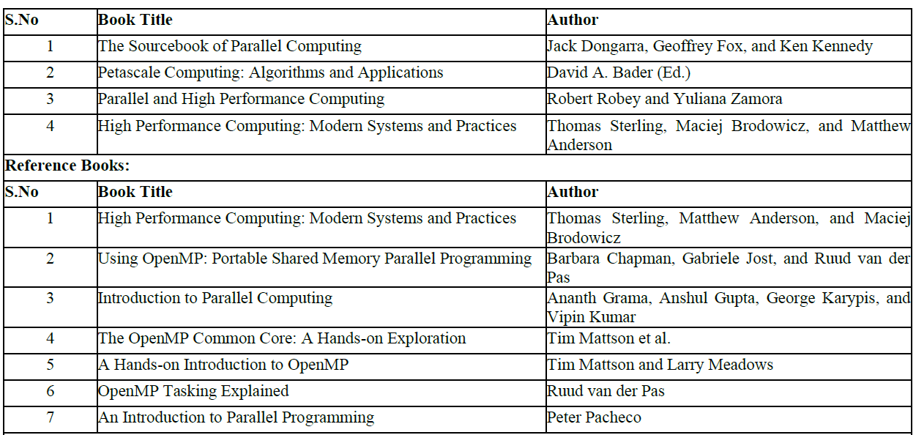
References

Slide 67
Recap
This unit provides us understanding of:
BLAS is a foundational library used to perform basic operations on vectors and matrices, Built on top of BLAS is LAPACK (Linear Algebra PACKage), a more advanced library used for solving complex linear algebra
Cluster computing involves connecting multiple computers (nodes) to work together as a single system to achieve higher computational power, reliability, and scalability
The design of clustering architectures is influenced by how resources are shared (e.g., shared-nothing or shared-memory), how communication occurs among nodes, and how workloads are distributed.
A distinction exists between mission-critical and business-critical applicationsIn such systems.
Fault detection is crucial and can be implemented using mechanisms like heartbeats, timeout detection, and probe-echo techniques.

Slide 68
Thank You

